Slide 1

Social Media Marketing

Slide 2
Goal Setting
Strengthen the positive sentiments prevailing about their brand.
Create new perception about the brand
E.g. Tata Nano

Slide 3
Strategy
Strategy consist of three main parts
  Content Strategy
  Target Group
  Platform

Slide 4
Content Strategy
70/20/10 Approach
It is simple framework which help to craft a balanced content
  Low Risk Content- Constitute 70% of the content i.e. Customer Engagement
  Medium Risk Content- 20% i.e. innovative
  High Risk Content- 10% , create expectation upfront

Slide 5
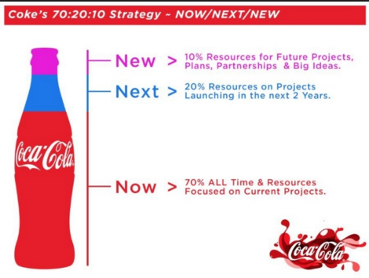

Slide 6
Content Strategy
50-50 Approach
Rule of thumb, not more than 50% of the content must be brand related.
Other 50% should be non-branded, mix of humor, entertainment etc.

Slide 7
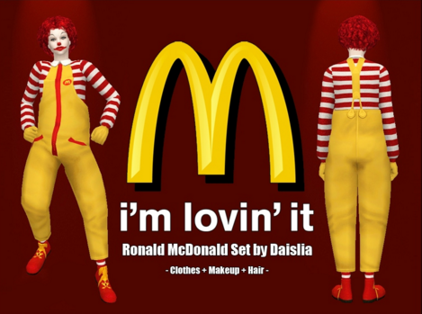
Content Strategy
Brand Mnemonic
This is learning technique that aids memory.
Strong communication tools , which help quick brand association and brand recall.
This may include logos, taglines, brand mascots etc.
e.g. McDonald

Slide 8

Content Strategy
Brand Story
It tends to communicate with the customers;
  What the brand believes in
  unique reasons for the existence of the brand
  e.g. Fonts, color, images, marketing messages

Slide 9
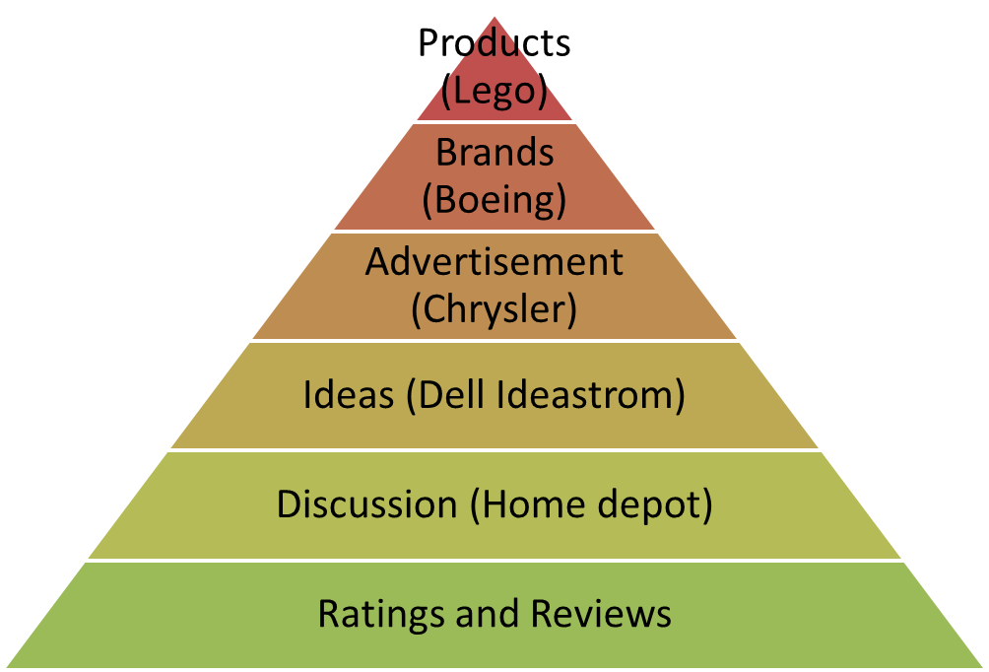
Content Strategy
Engagement Ladder

Slide 10
Successful Social Media Strategy
Target Group
Clearly defining target, specific set of audience
Content strategy should be different for different target groups.
Audience | Interests
Customer | Product benefits, features, discounts, price, delivery etc.
Opinion Leaders | Industry insight, forecasts, new product development, innovation etc.
General Public | Humor, Entertainment, CSR etc.

